Slide 1
HAND GESTURE CONTROLLED VIRTUAL MOUSE USING ARTIFICAL INTELLIGENCE
TITTLE:

Slide 2
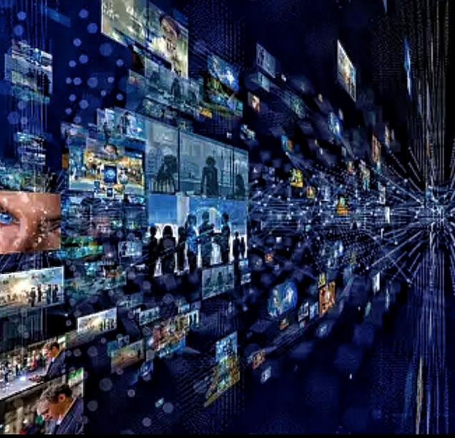
Content
Introduction
Overview
Components
Prominence and motive
Conclusion

Slide 3

Introduction
The use of hand gesture recognition in controlling virtual devices has become popular due to the advancement of AI technology. In this paper, a hand gesture-controlled virtual mouse system is proposed, which utilizes AI algorithms to recognize hand gestures and translate them into mouse movements. This system aims to provide an alternative interface for people who have difficulty using a traditional mouse or keyboard. The proposed system is designed to be scalable and adaptable to different types of environments and devices. Its use of hand gesture recognition can provide a more intuitive and natural way of interacting with virtual devices, making it a promising area of research and development.

Slide 4
Overview
Cutting-edge technology: Hand gesture-controlled virtual mouse using AI is a state-of-the-art technology that enables users to interact with computers or digital devices without physical touch, solely through hand gestures.
Combines multiple techniques: This innovative system combines computer vision, machine learning, and gesture recognition techniques to interpret and respond to hand movements accurately.
Computer vision: The system uses a camera to capture images of the user's hand, which are then processed by computer vision algorithms to recognize the gestures being made.
Machine learning: The system is trained using a dataset of hand gestures to recognize different gestures. Once the gesture is recognized, it is translated into a corresponding mouse movement.
Gesture recognition: The system utilizes gesture recognition techniques to accurately interpret and respond to hand movements, providing a more intuitive and natural way of interacting with virtual devices.
Adaptable and scalable: The proposed system is designed to be scalable and adaptable to different types of environments and devices, making it a promising area of research and development..

Slide 5
Enhanced User Experience. Accessibility and Inclusivity. Efficiency and Productivity. Seamless Integration with Emerging Technologies. Adaptability and Personalization . Robustness and Reliability.
Aspects

Slide 6
Components
Implementing robust AI algorithms for real-time hand gesture recognition, ensuring high
accuracy and reliability across diverse user scenarios and environments.
Designing an intuitive and user-friendly interface that enables seamless interaction with
digital interfaces, minimizing learning curves and usability barriers.
Enhancing accessibility by providing customization options and accessibility features
tailored to users with diverse needs and abilities.
Optimizing system performance for efficiency and scalability, enabling deployment across
various hardware platforms and software environments.
Addressing security and privacy concerns through robust authentication mechanisms, data
encryption, and privacy-preserving design principle

Slide 7
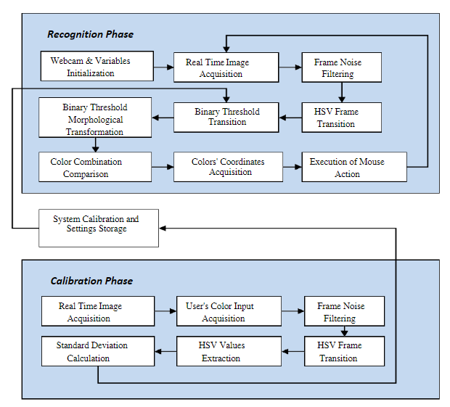
Prominence and motive

Slide 8
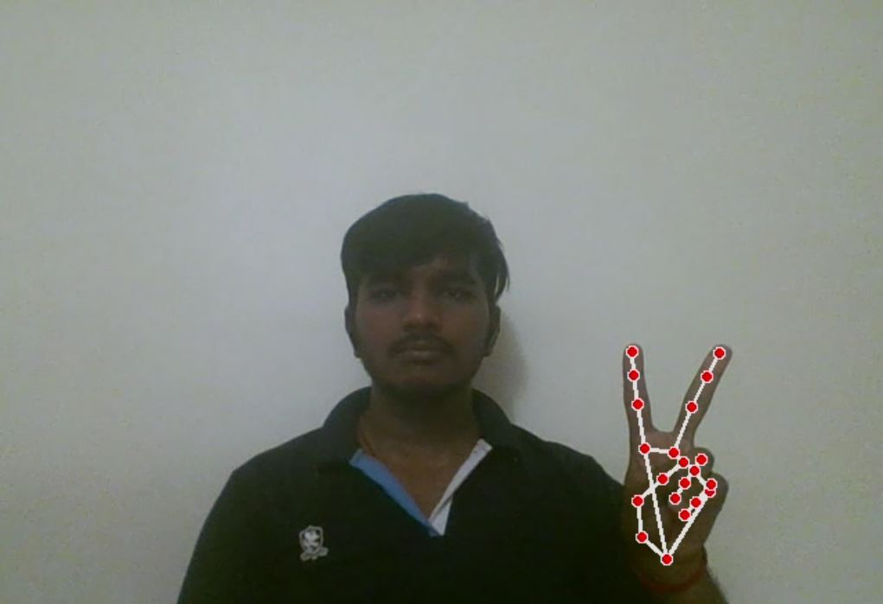
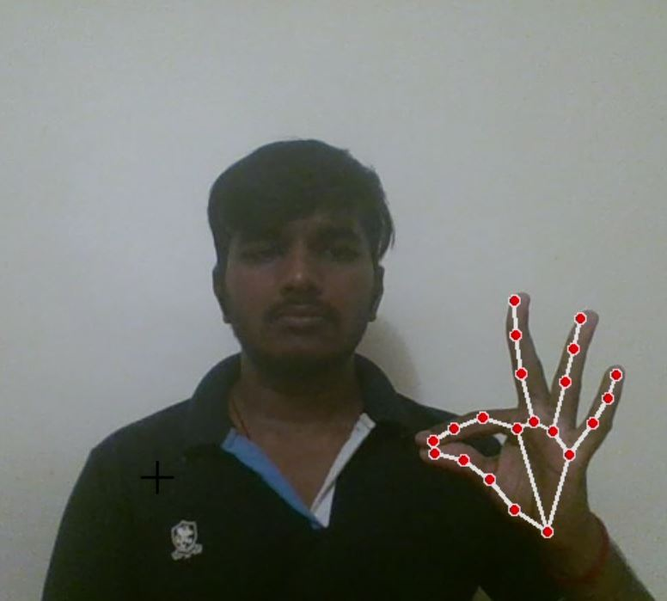
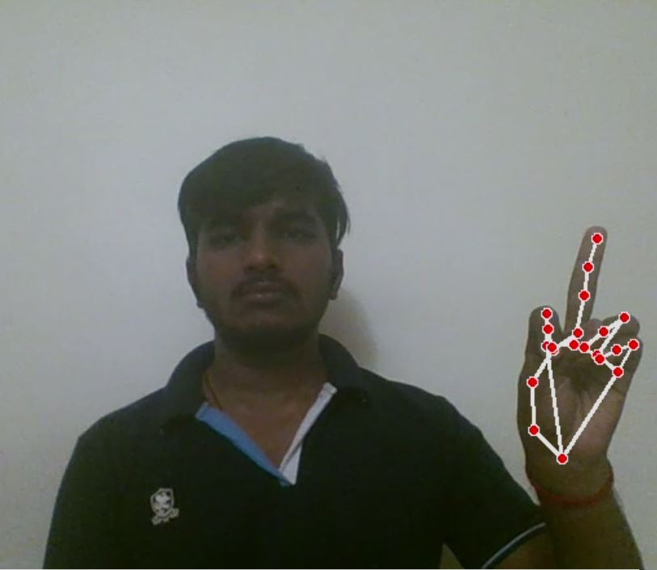
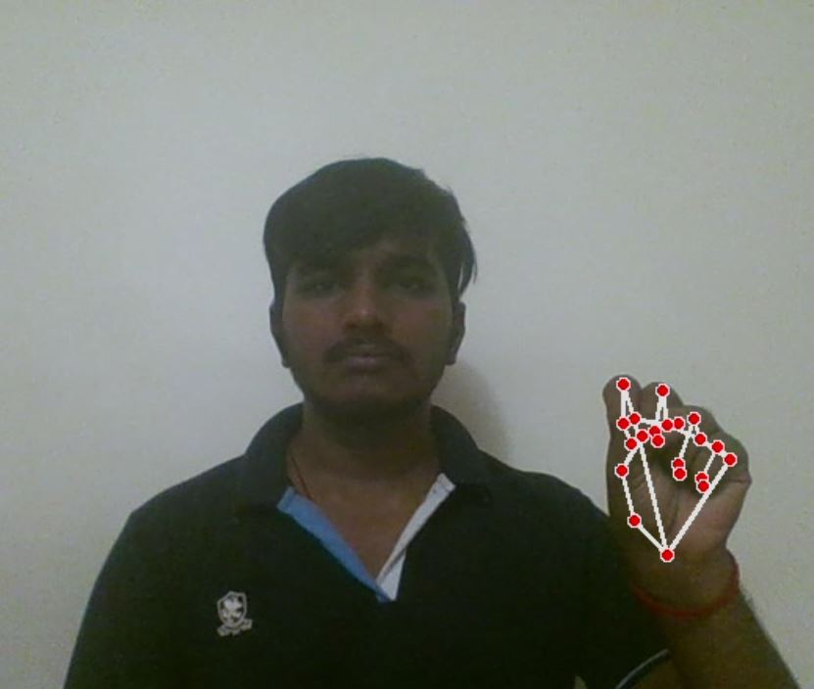
For the Mouse Cursor Moving around the Computer Window
To perform scrolling operation.
To Perform Right Button Click operation.
To perform drag and drop operation.
Other operations:
To Perform Left Button Click operation
To perform a double click operation.
To perform volume controlling.
To perform brightness controlling.
For No Action / neutral gesture to be Performed on the Screen

Slide 9
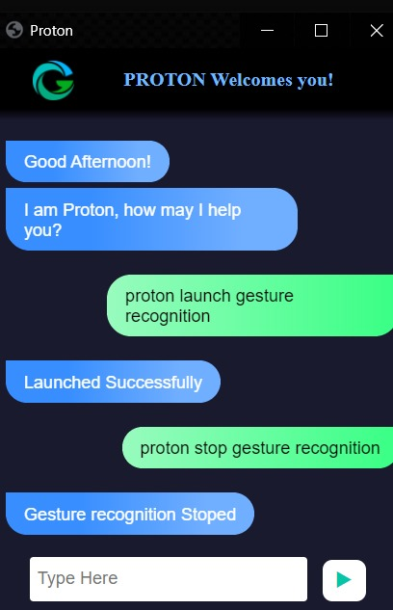
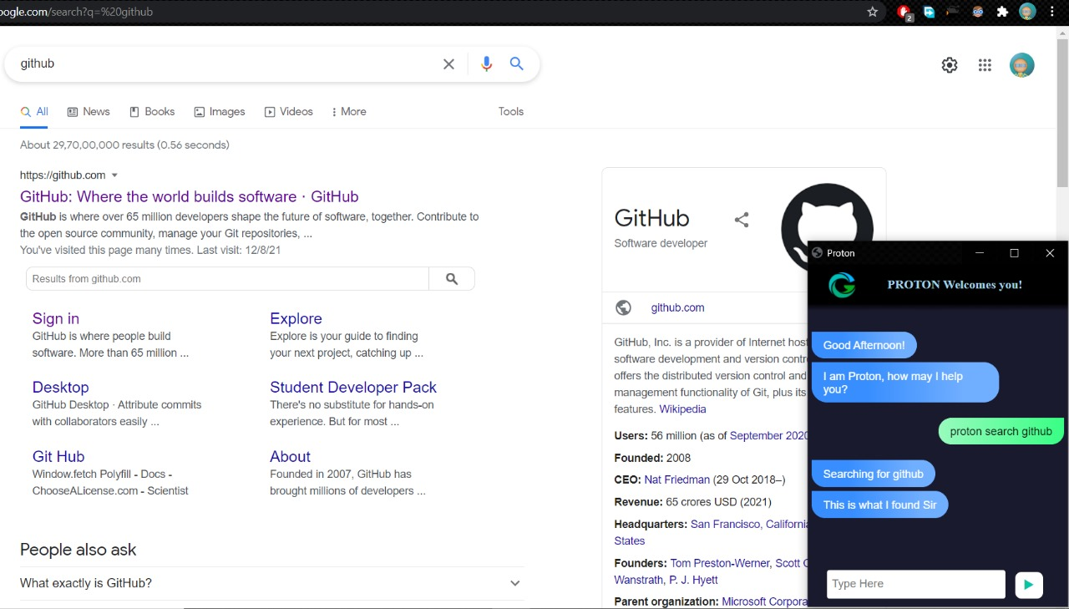
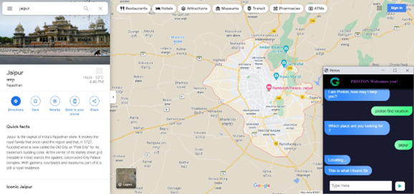
To launch and end the gesture recognition
To search for something over internet
To find a location what we are looking for
Also to get an idea about Date and time.
To exit voice assistant Can be done.

Slide 10
Conclusion
A revolutionary technology using hand gestures and real-time camera, allowing natural and intuitive control of the cursor without a traditional mouse. With voice assistant integration, users can open apps, navigate menus, and search the web through voice commands, making it an accessible solution for all.
Benefits:
Intuitive and natural cursor control
Increased accessibility
Voice assistant integration for added functionality
Use Cases:
Presentations
Gaming
Accessibility for people with disabilities
Future
Continuous evolution and innovation
Improved user experience
Expanded accessibility for all.

